Slide 1

SQL Server Indexes - Back To The Basics
Satya Ramesh
@SatyaRamesh230
Satya@SQLMaestros.com

Slide 2
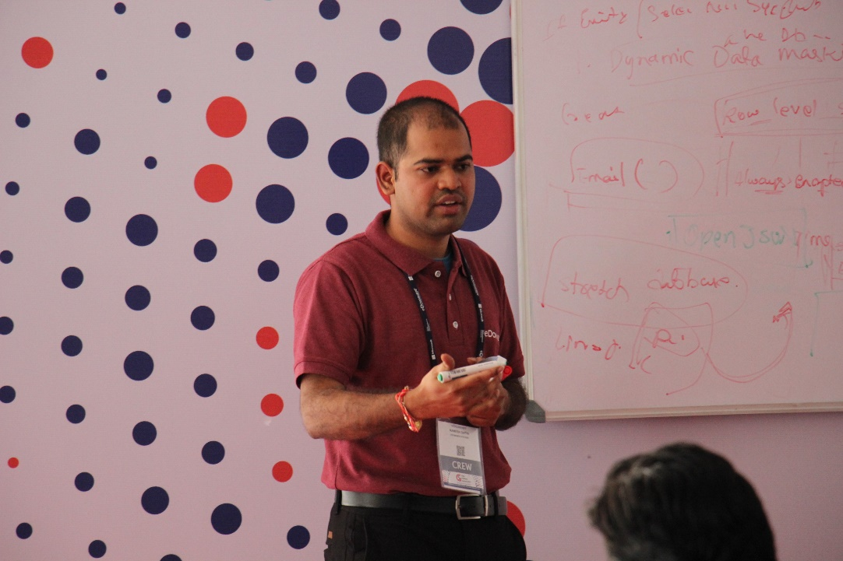
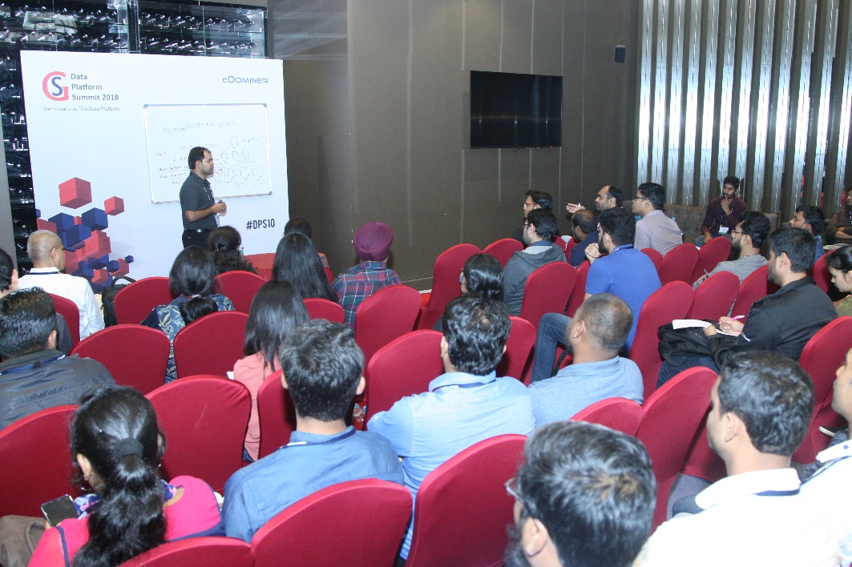
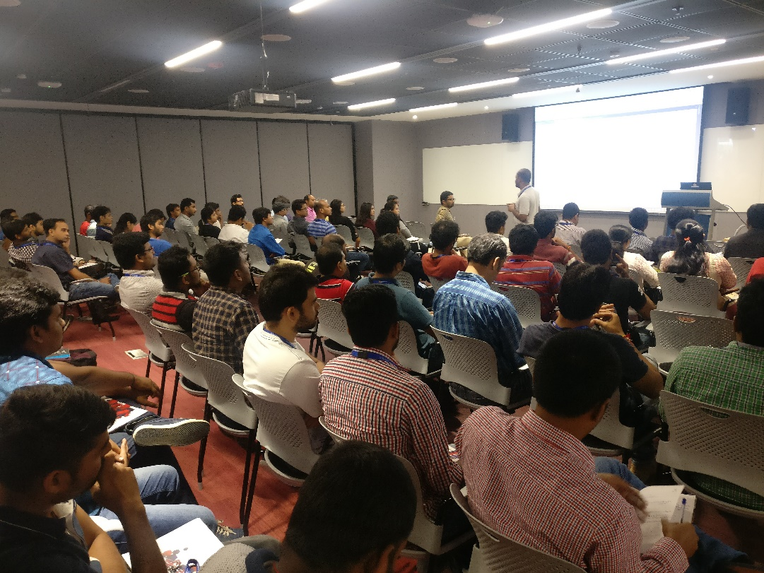
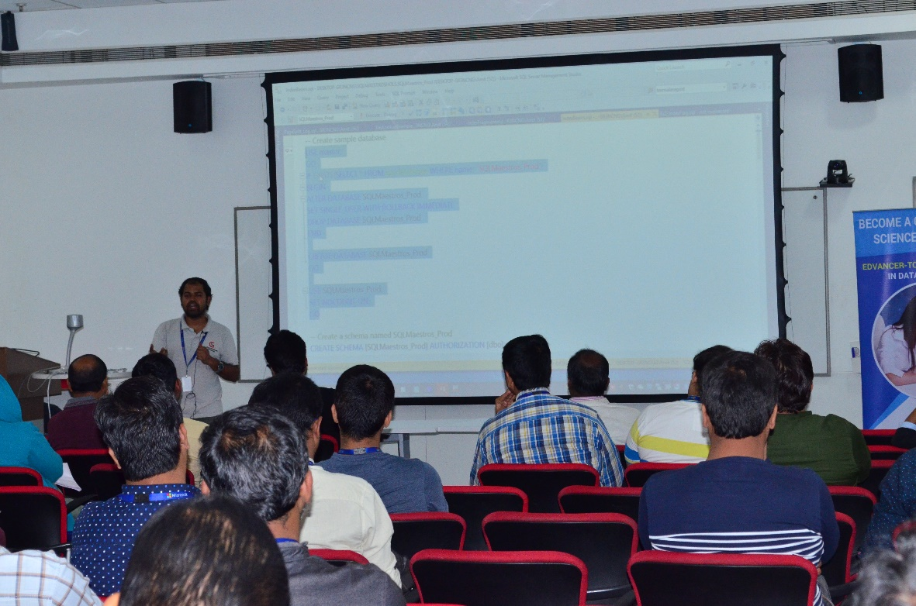
About Satya Ramesh
Sr. Consultant – SQLMaestros.com (unit of eDominer Systems)
Frequent speaker at Data Platform Day Events and Webinars organized by DataPlatformGeeks
Learn More – www.SQLMaestros.com/satya-ramesh
Follow me on Twitter: @satyaramesh230

Slide 3
Agenda
What is an Index?
Clustered Indexes (Row Store)
NonClustered Indexes (Row Store)
Good Candidate For A Clustered Index
Covering Index
Page Splits, Fragmentation and Fill Factor
Note: This presentation does not cover the Columnstore indexes and indexes on XML and spatial data type columns.

Slide 4
What is an Index?
Indexes helps us in reaching to the data faster
Clustered Index
One per table
NonClustered Index
Can have 999 per table
A table without clustered index is a HEAP

Slide 5
CREATE CLUSTERED INDEX CL_HOLs_Column1
ON [SQLMaestros_Prod].[HOLs](Column1);
CREATE NONCLUSTERED INDEX CL_HOLs_Column4
ON [SQLMaestros_Prod].[HOLs](Column4);
Root Node
Root Node
A-Z
A-Z
A-M
N-Z
Intermediate Node
A-M
N-Z
Intermediate Node
A-F
G-M
N-S
T-Z
A-F
G-M
N-S
T-Z
Data Pages
Ref to Data
Leaf Node
Leaf Node

Slide 6
Good Candidate For A Clustered Index
column is narrow
Fixed length data type
Ever increasing nature of data (Eg: IDENTITY Column)

Slide 7

Action Time!
DEMO

Slide 8
Index Fragmentation
Sys.dm_db_index_physical_Stats
<5% - IGNORE
>5% and < 30 – REORGANIZE
> 30 % - REBUILD

Slide 9
Action Time!
DEMO

Slide 10
Summary
What is an Index?
Clustered Indexes (Row Store)
NonClustered Indexes (Row Store)
Good Candidate For A Clustered Index
Covering Index
Page Splits, Fragmentation and Fill Factor

Slide 11
Reference:
https://docs.microsoft.com/en-us/sql/relational-databases/sql-server-index-design-guide?view=sql-server-ver15

